Slide 1

Website specializing in selling computer accessories
Hoàng Tiến Đạt – 22IT.EB012

Slide 2

Topic goal
Increase the number of existing customers and attract new customers to increase sales.
Support customers to shop and order online through the electronic payment system, saving time and increasing convenience.
Provide complete information about the products listed for sale.
Website interface easy to use for customers.

Slide 3
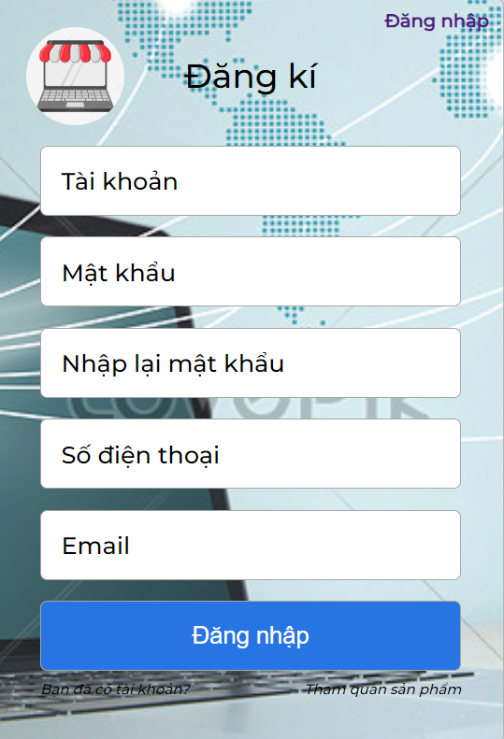
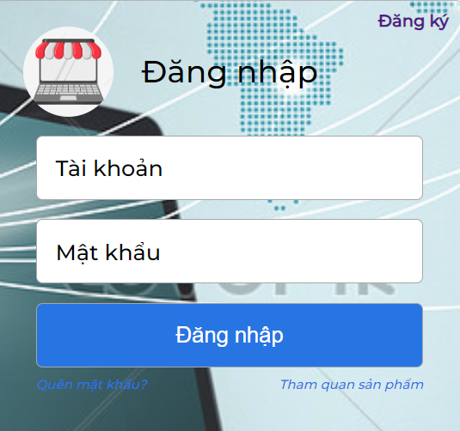
Registration and login page interface
The registration section allows registered users to access and buy products on the website and also register personal information with the website to make it easier to buy and sell products.

Slide 4
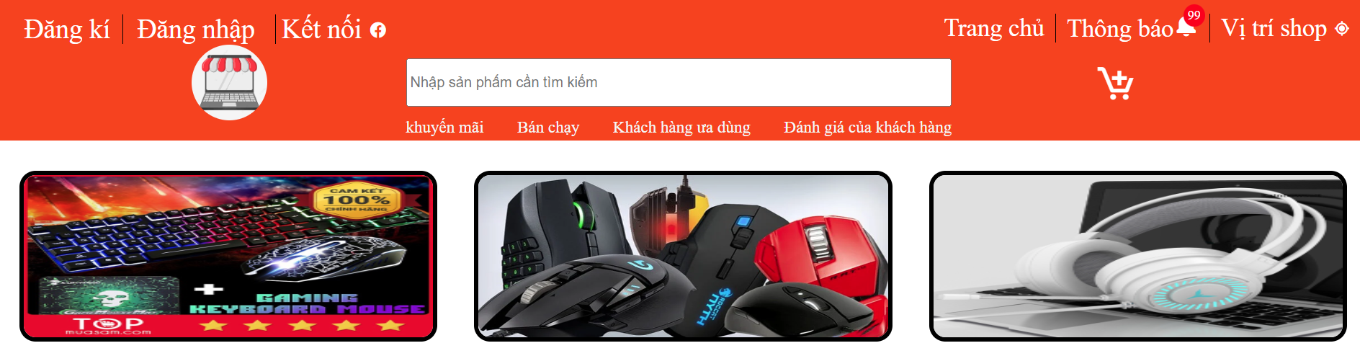
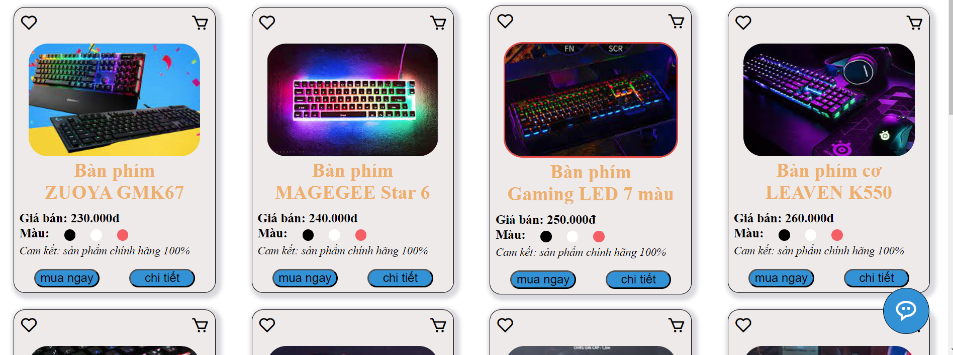

Home page interface
Home page includes:
+ menu
+ some featured products
+ contact information for customers
+ chat online customer support

Slide 5
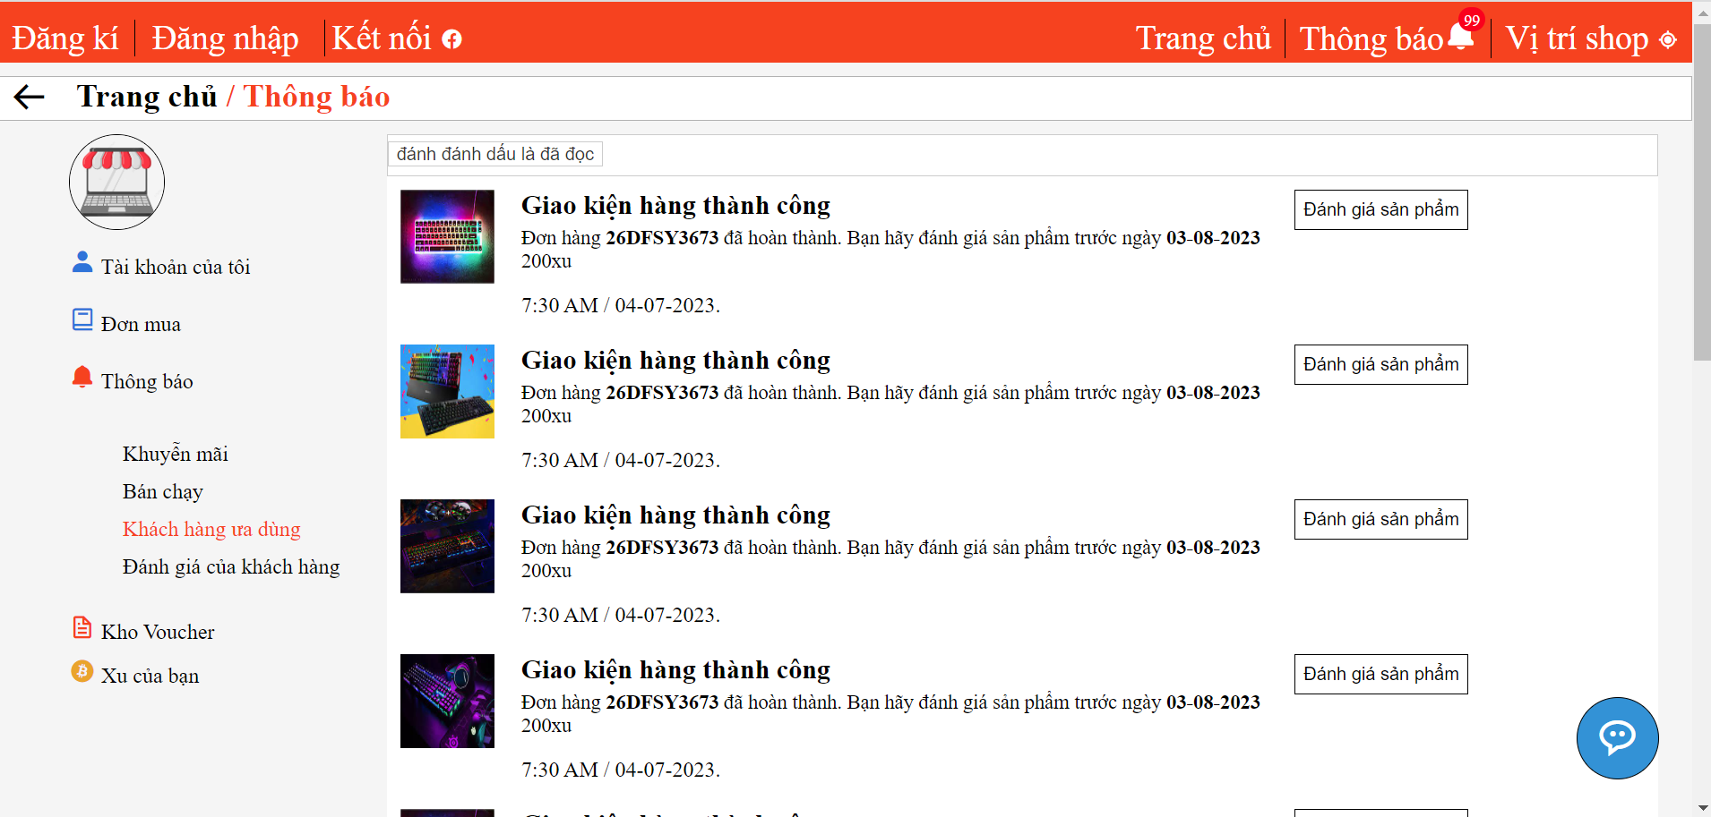
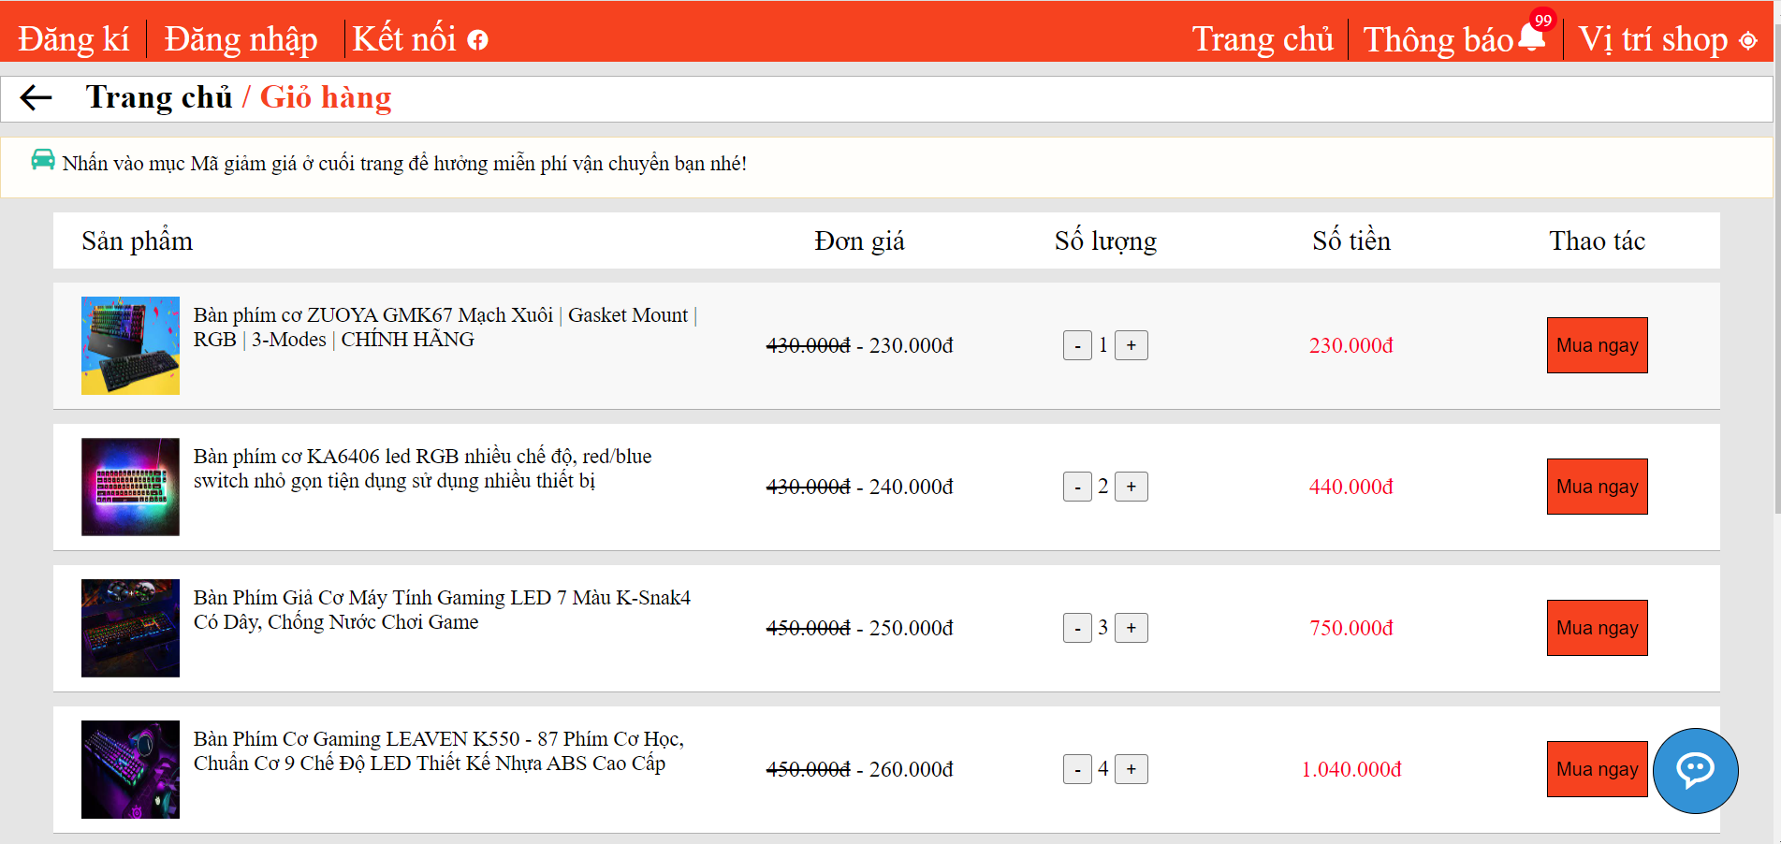
Menu includes: + register an account + login account + location of the shop on the map + notification + shopping cart + product search
Notification page interface
Cart page interface

Slide 6
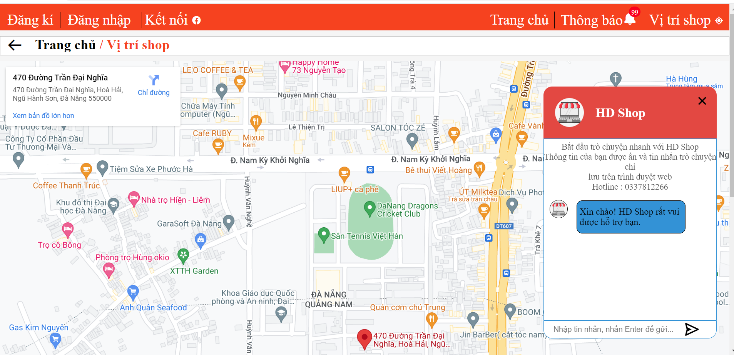
The interface of the website's customer support and contact pages
This support and contact interface is intended to answer questions that customers have.
At the same time, it also includes a shop address so that customers can come to exchange directly.

Slide 7
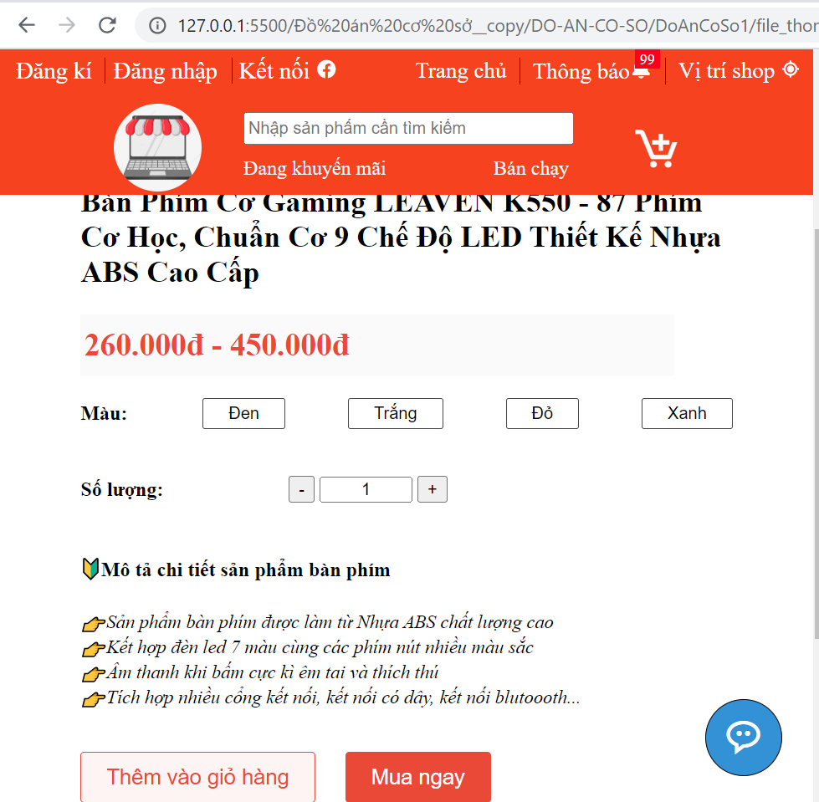
Product purchase page interface
There are many choices for customers, so that customers have the best possible experience.
At the same time, all the interfaces of the pages have been responsive to a variety of screen sizes.

Slide 8

Thank you for listening

